Slide 1
Deletion of the root of a heap and heap sort

Slide 2
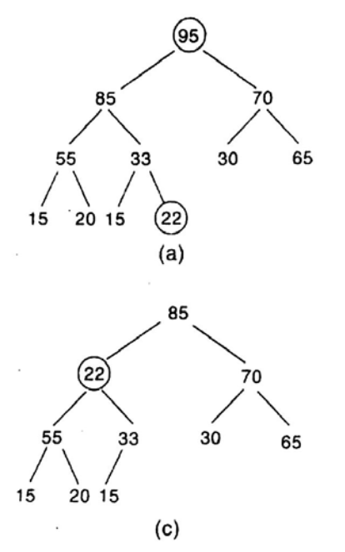
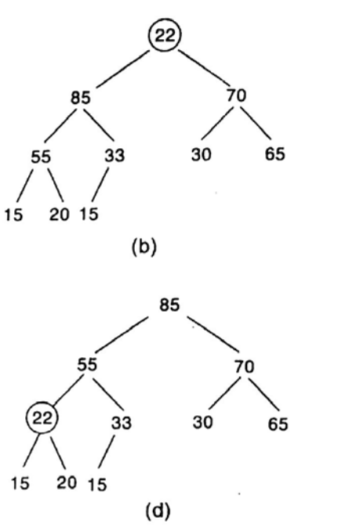
Deleting the Root of a Heap
Assign the root R to some variable ITEM.
Replace the deleted node R by the last node L of H so that H is still a complete tree, but not necessarily a heap.
Reheap

Slide 3
DELHEAP(TREE, N, ITEM)

Slide 4

Example

Slide 5
Heap Sorting
Phase A: Build a heap H out of the elements of A.
Phase B: Repeatedly delete the root element of H.
Since the root of H always contains the largest node in H, Phase B deletes the elements of A in Decreasing Order.

Slide 6
HEAPSORT(A, N)
Repeat for J=1 to N-1:
Call INSHEAP(A, J, A[J+1])
Repeat while N>1:
Call DELHEAP(A, N, ITEM)
Set A[N+1] := ITEM
EXIT

Slide 7
Heap Sort
97
95
88
95
88
95
66
55
95
48
66
55
48
Before Taken
After Taken
97

Slide 8
Heap Sort (Cont...)
95
95
88
95
88
48
66
55
48
66
55
Before Taken
After Taken
97 | 95

Slide 9


Heap Sort (Cont...)
95
88
88
48
66
66
55
55
Before Taken
After Taken
97 | 95 | 95

Slide 10
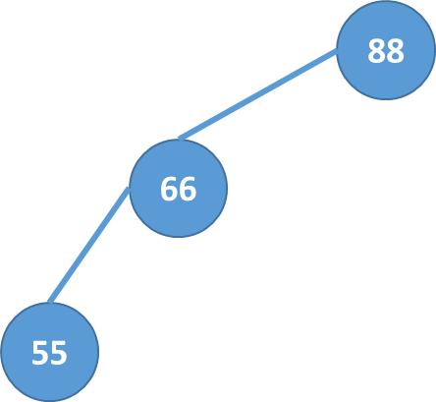

Heap Sort (Cont...)
66
55
Before Taken
After Taken
97 | 95 | 95 | 88

Slide 11

Heap Sort (Cont...)
66
55
55
48
Before Taken
After Taken
97 | 95 | 95 | 88 | 66

Slide 12
Heap Sort (Cont...)
55
48
48
Before Taken
After Taken
97 | 95 | 95 | 88 | 66 | 55

Slide 13
Heap Sort (Cont...)
48
Before Taken
After Taken
97 | 95 | 95 | 88 | 66 | 55 | 48

Slide 14
Heap Sort (Cont...)
Sorted array:
97 | 95 | 95 | 88 | 66 | 55 | 48

